Slide 1

Time Consumption Analysis
We discovered that the service station offers three primary service types: Preventive Maintenance Service (PMS), Repair and Replacement (RR), and Breakdown Assistance and Parts Procurement (BANDP).
In the Phase 4 analysis, we analyzed three months of service center data and encountered around 3,469 service records, which we analyzed using 17 different technicians.
We analyzed data attributes that included entry date and time, ready date and time, service type, car model, and technician who worked on the car.
Statistical Analysis:
Our next analysis was a statistical model, one-way ANOVA classification. This analysis gave us insight into the average service time of different service types in comparison to one another.
The service type with the longest average time was Repair and Replacement (RR), followed by Breakdown Assistance and Parts Procurement (BANDP).

Slide 2
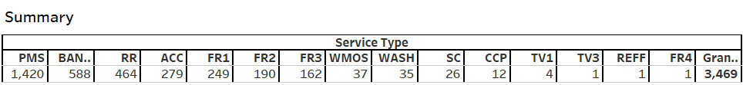
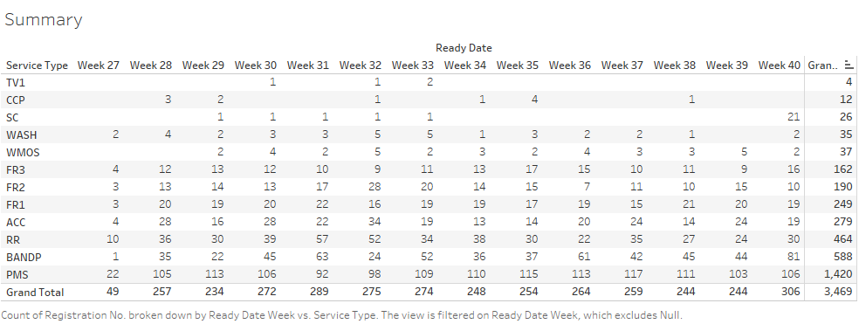
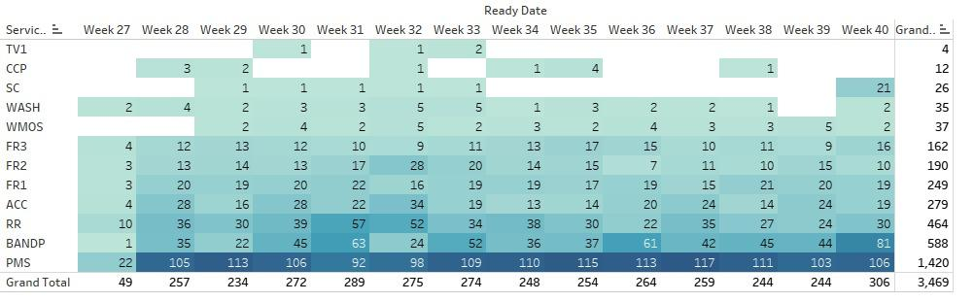
We analyzed the Service that done in the service station in each & every service that done in the past 3 months data , in primarily the station encountered most of the service in the Preventive Maintenance Service (PMS), Repair and Replacement (RR), and Breakdown Assistance and Parts Procurement (BANDP).
We have done the analysis in week wise over the three month period of time , we found service that encounter by the station is almost consistent in the over period of time .

Slide 3
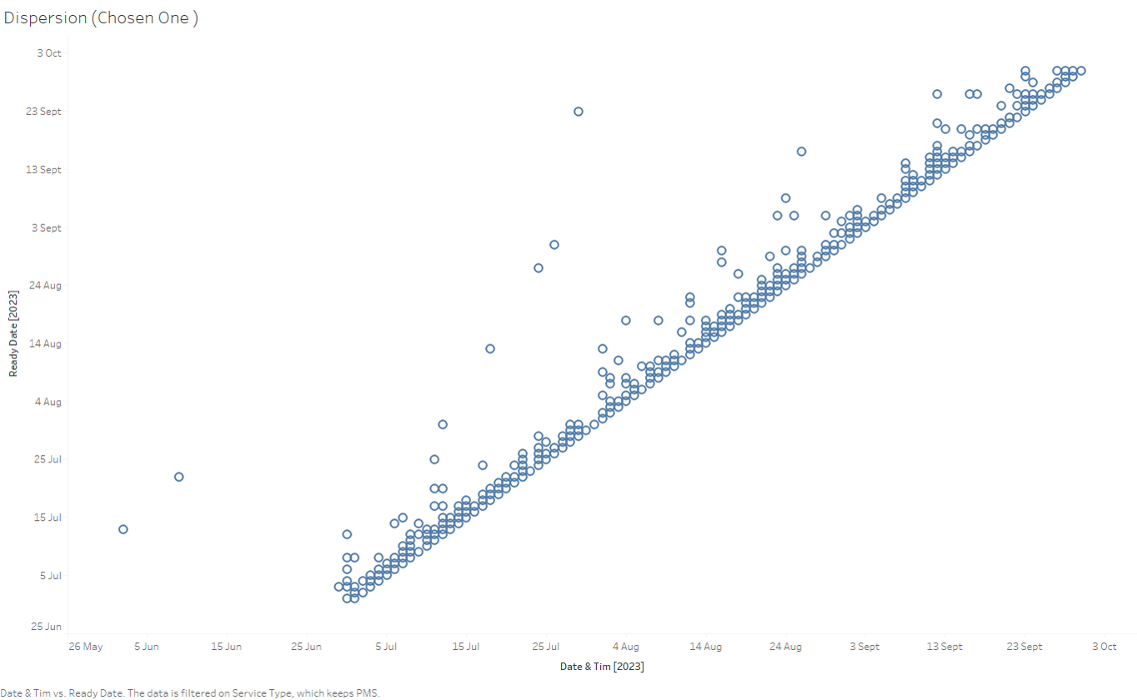
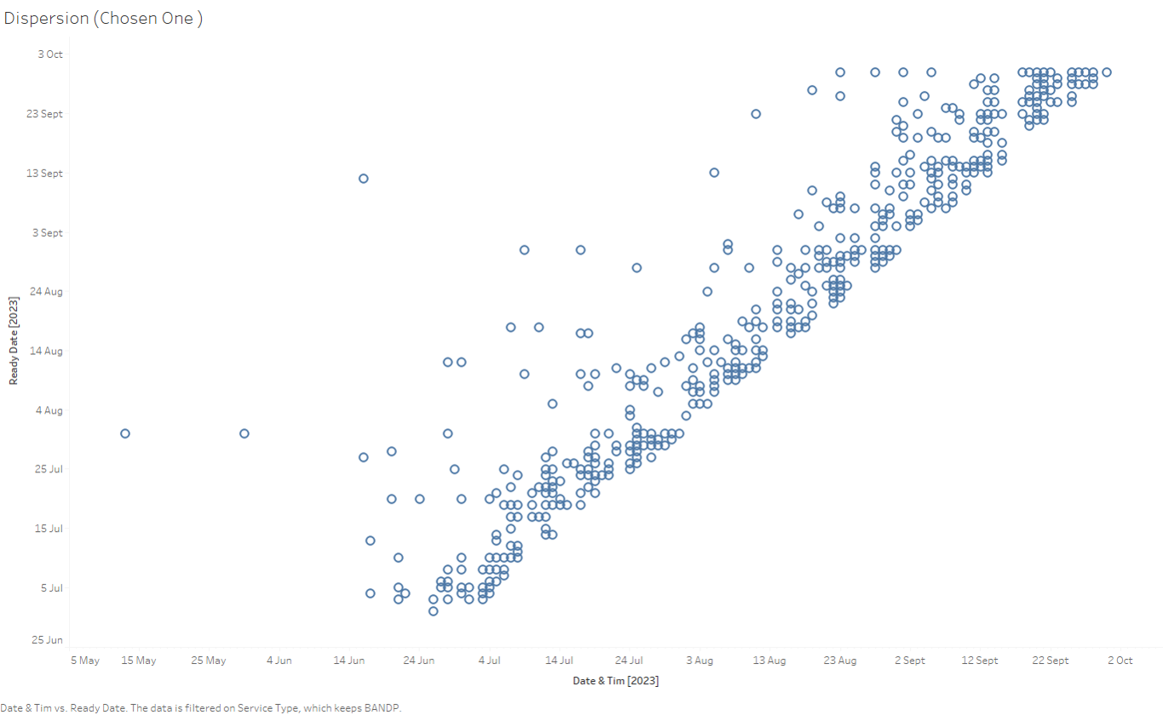
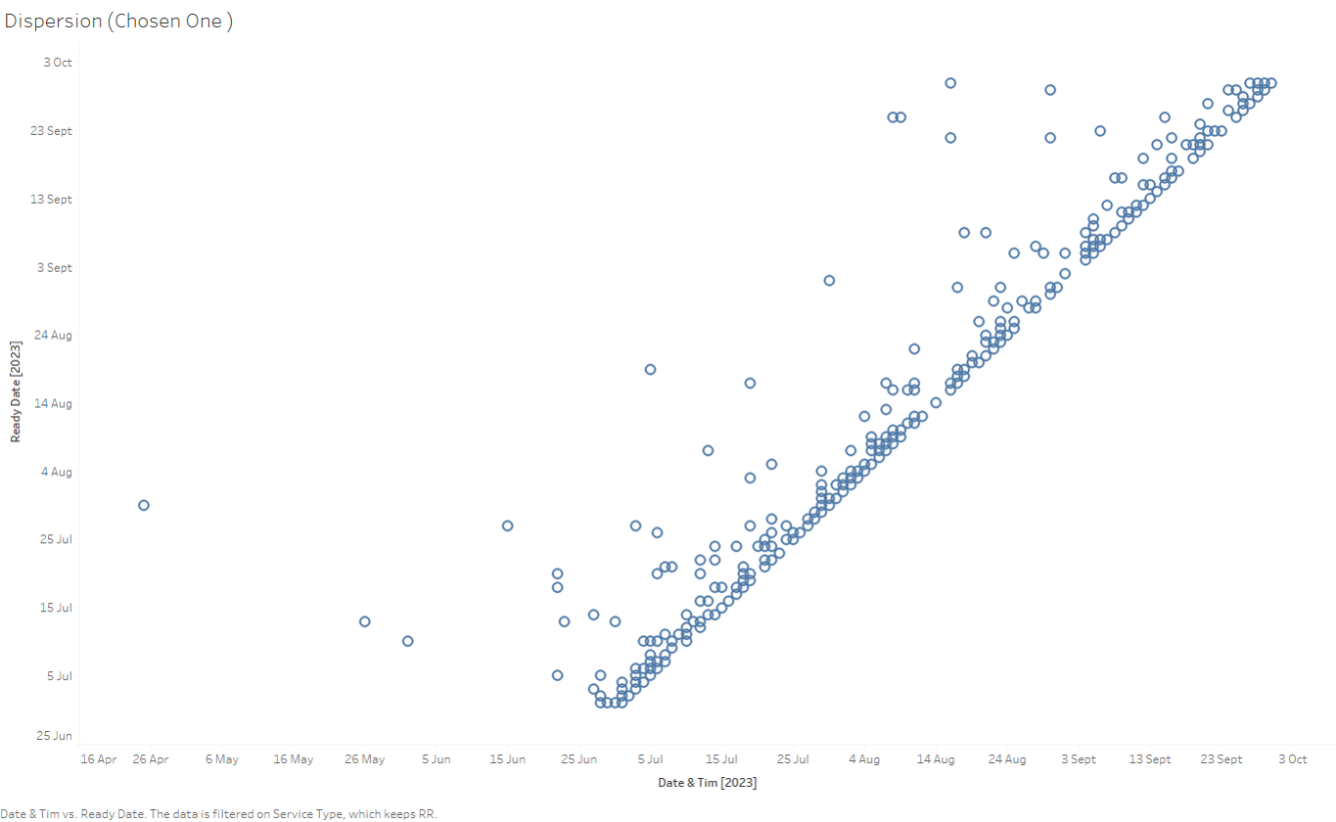
Dispersion In Completing BANDP Service
PMS
RR
In the scatter plot depicting the duration of BANDP service from car arrival to completion, we noticed a significant dispersion. BANDP, which accounted for 57% of service time among 588 encounters, was managed by a single technician.
The scatter plot shows a relatively tight distribution of PMS service times. On average, PMS service accounted for 19.67% of the total service time for the car during its service life.

Slide 4

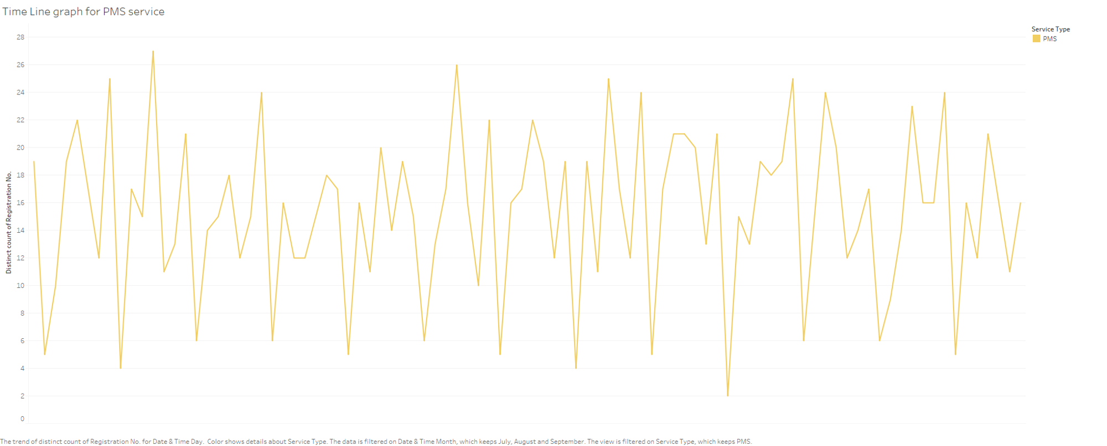
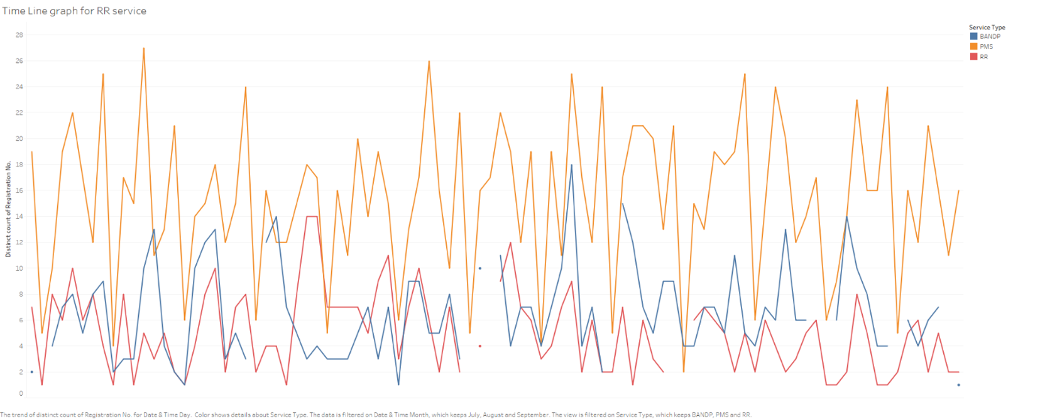
This graph represents the data wise analysis of car services requests based on their service type. Through the graph we can see that there is pattern when we consider the PMS services, which is Periodic maintenance service. It spikes on Wednesdays and Saturdays, while have minimum requests on Sundays .It indicates that we can expect low encounters in Sunday and high encounters in Wednesday and Saturday in a week .

